Slide 1
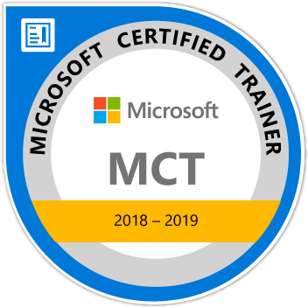
Learning MVC 6
Maruti Makwana
Microsoft Certified Trainer
www.microsofttrainer.in

Slide 2
What is MVC?

Slide 3
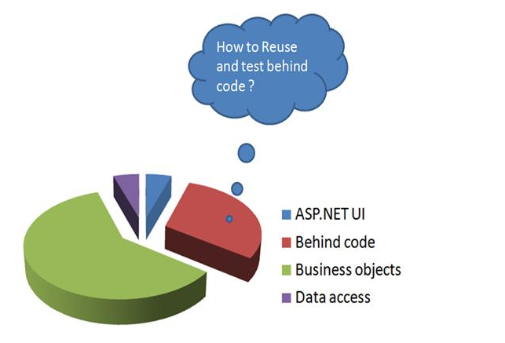
Why MVC ?

Slide 4
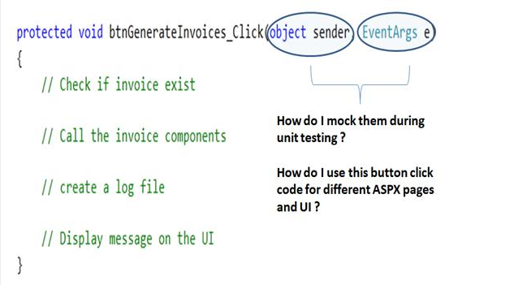

Slide 5
What is difference between Asp.Net Web application and MVC web application?

Slide 6
What is MVC 6?
Which is based on dot net core framework
NOT on dot net framework

Slide 7
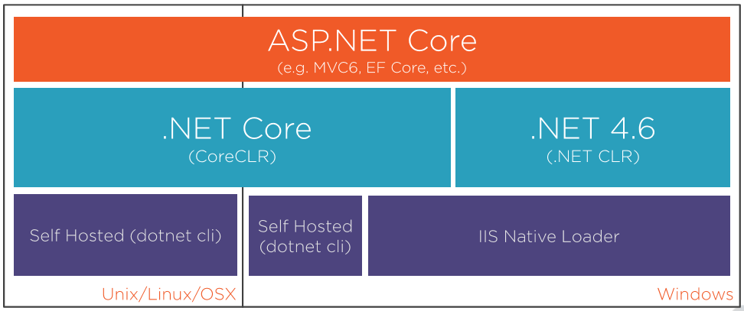

Slide 8
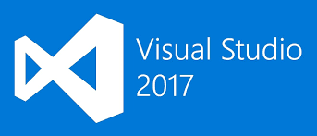

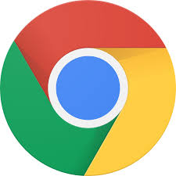

Required Tools and Software
Google Chrome

Slide 9
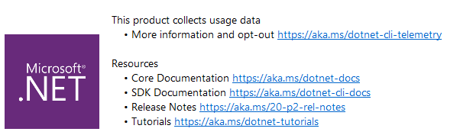

Slide 11
What is ASP .Net Core?
ASP.NET Core is an open source and cloud-optimized web framework for developing modern web applications that can be developed and run on Windows, Linux and the Mac.
It includes the MVC framework, which now combines the features of MVC and Web API into a single web programming framework.

Slide 12
Why to choose ASP. Net Core?
ASP.NET Core is an open source and cloud-optimized web framework for developing modern web applications that can be developed and run on Windows, Linux and the Mac.
It includes the MVC framework, which now combines the features of MVC and Web API into a single web programming framework.
ASP.NET Core apps can run on .NET Core or on the full .NET Framework.
It was architected to provide an optimized development framework for apps that are deployed to the cloud or run on-premises.

Slide 13
Why to choose ASP. Net Core?
ASP.NET Core apps can run on .NET Core or on the full .NET Framework.
It was architected to provide an optimized development framework for apps that are deployed to the cloud or run on-premises.
Built-in support for dependency injection.
Tag Helpers which makes Razor markup more natural with HTML.
The benefits of a smaller app surface area include tighter security, reduced servicing, improved performance, and decreased costs

Slide 14
Before ASP.Net Core let’s See.Net Core

Slide 15
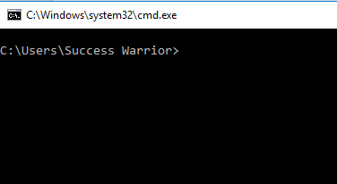
Let’s Understand dotnet code with simple application
Open
Command
prompt

Slide 16
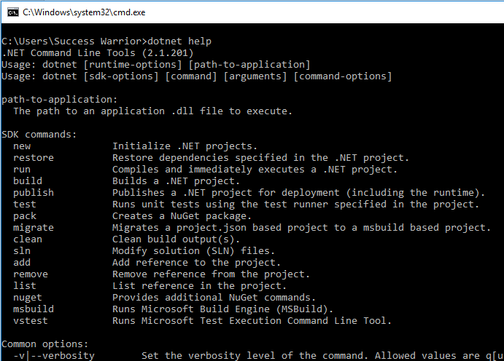

Slide 17
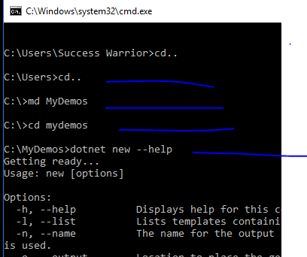

Slide 18
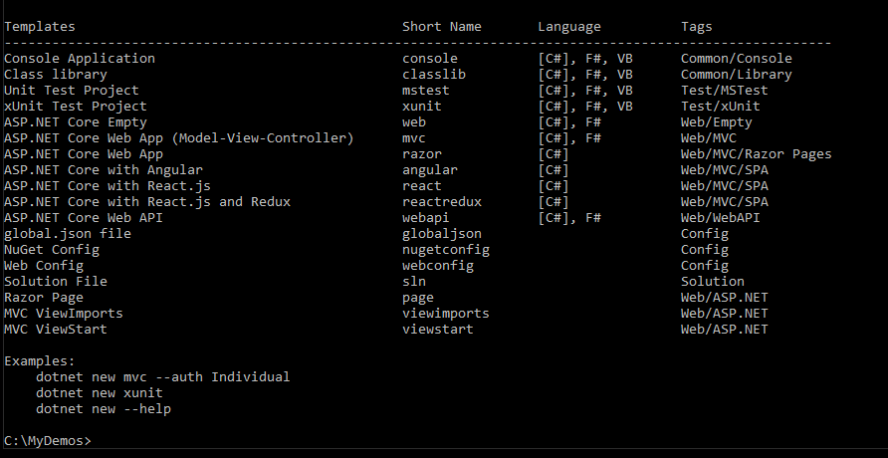
We can create any of these projects using dotnet command

Slide 19
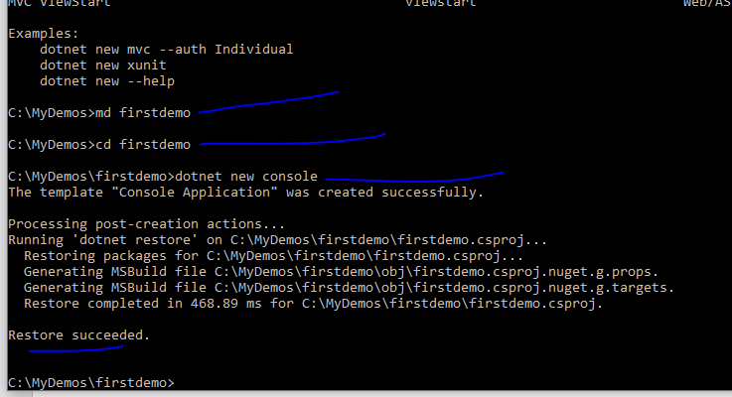
We created new console applicaiton

Slide 20
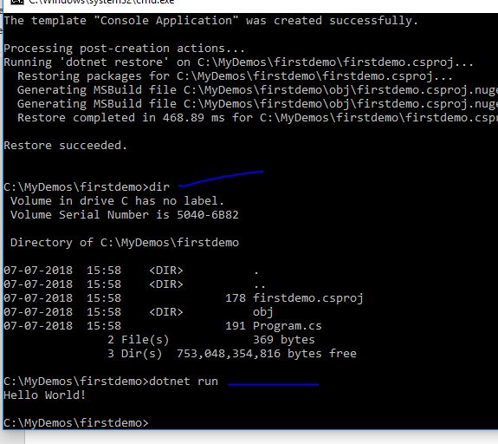
We got new project with very simple project
And its running

Slide 21
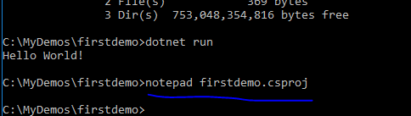
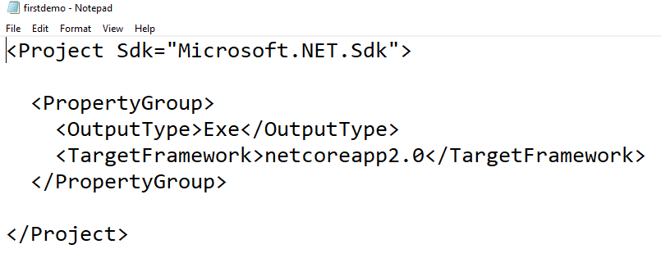
A very simple
csproj file

Slide 22
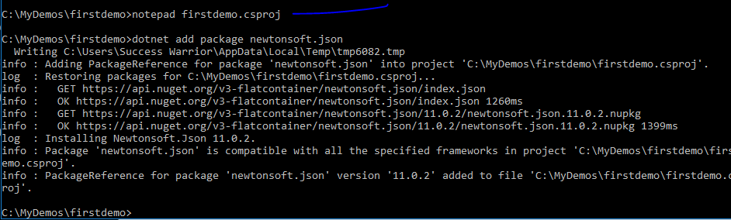
Adding new package using npm

Slide 23
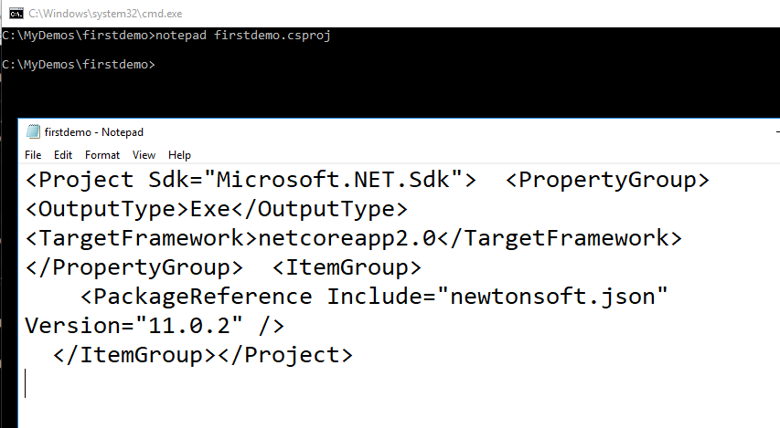
Csproj file will get changed and package is added

Slide 24
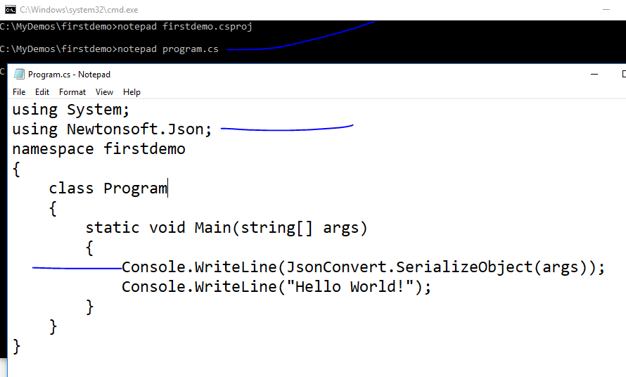

Slide 25
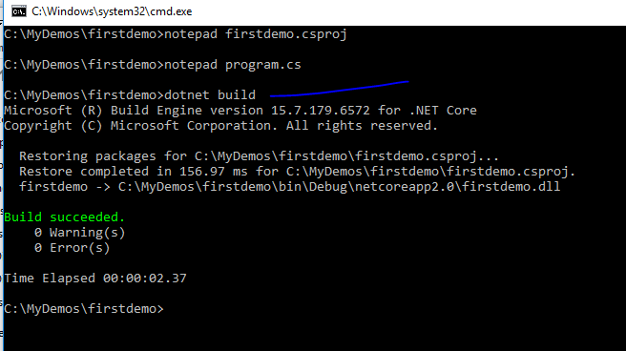

Slide 26
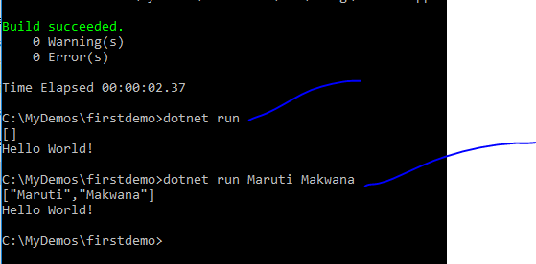

Slide 27
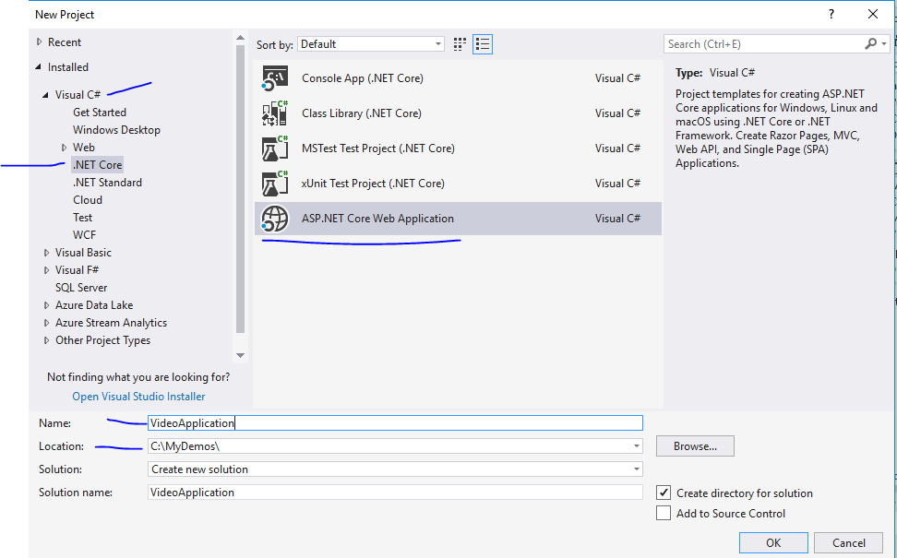

Slide 28
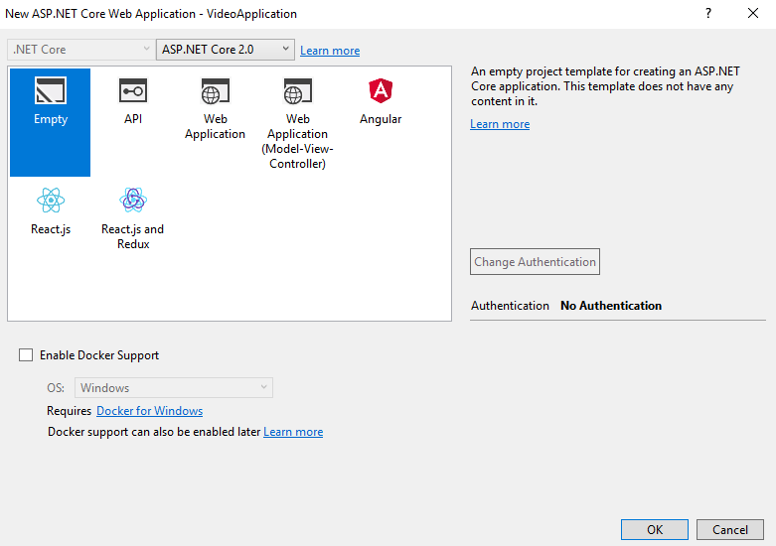

Slide 29
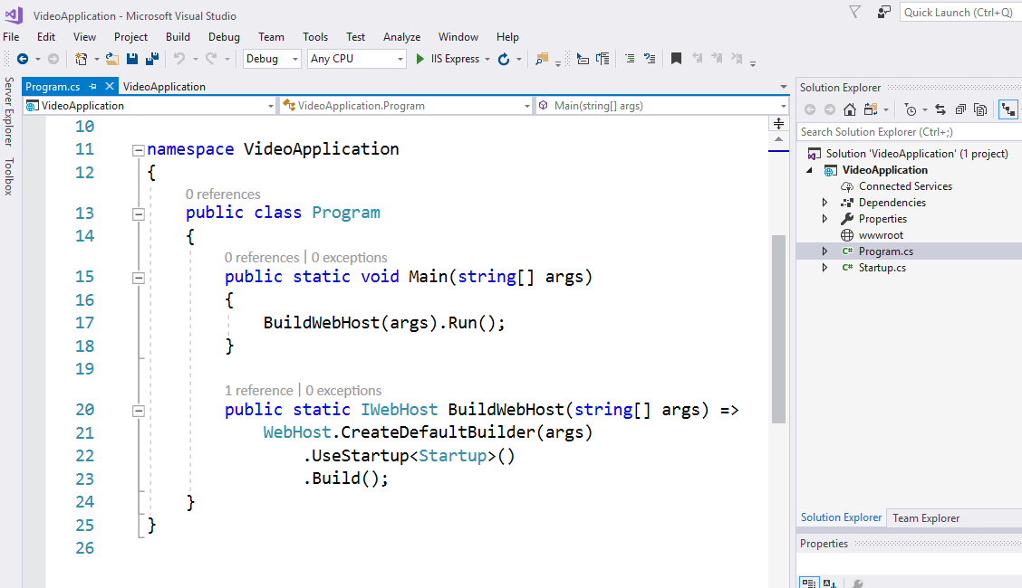

Slide 30
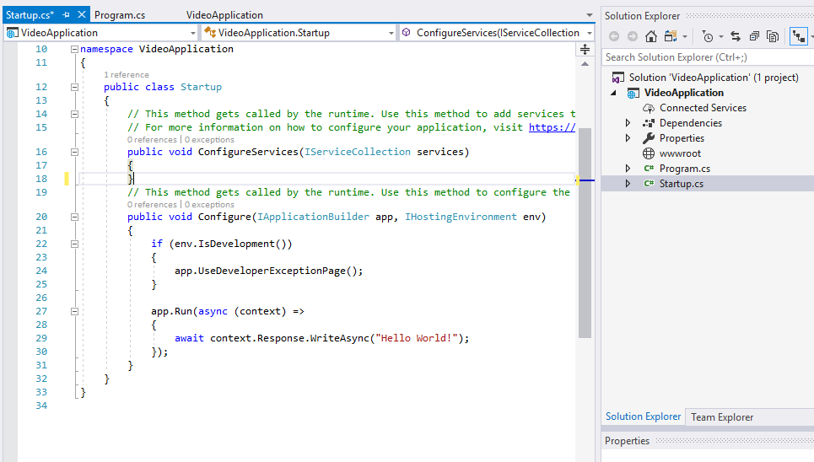
For any request that comes in just write out helloworld

Slide 31
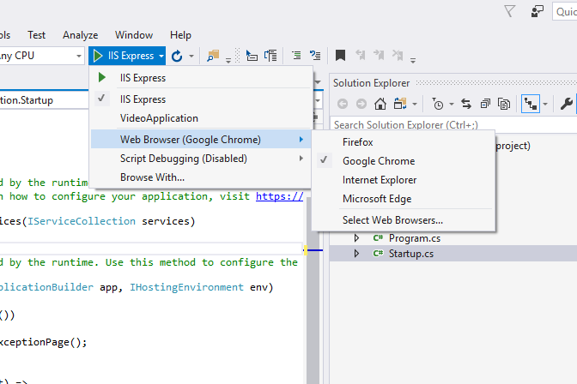

Slide 32
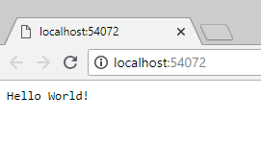
Even if you check view source this is just text
Which we are returning – No html page till now

Slide 33
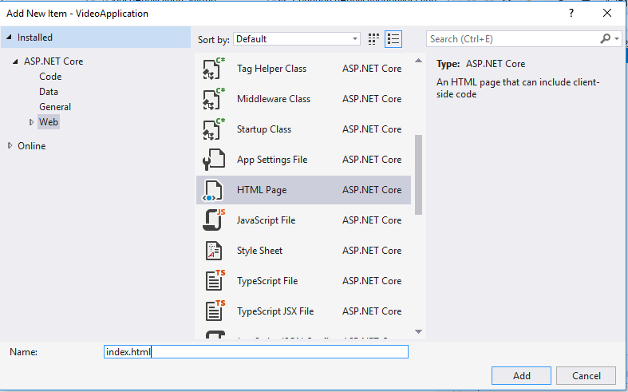

Slide 34
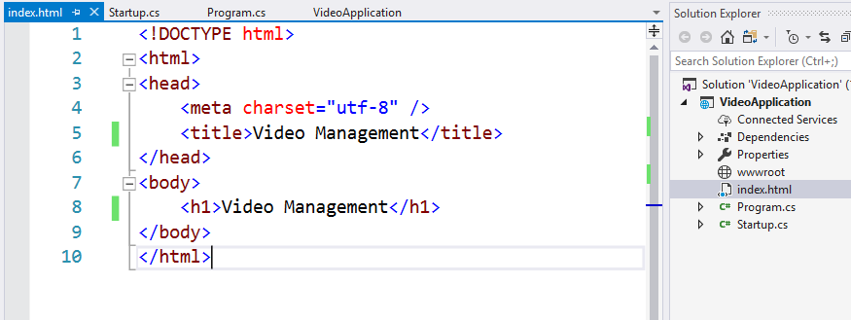

Slide 35
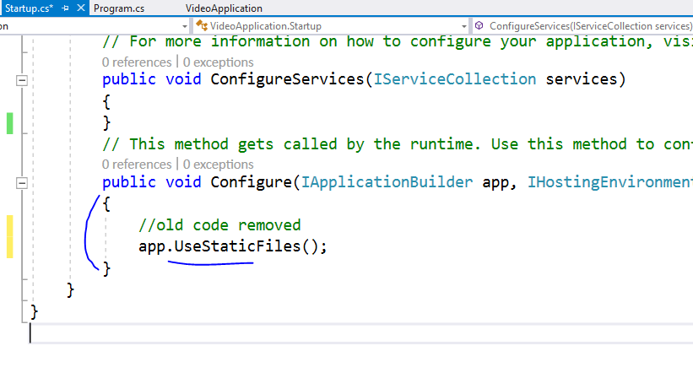

Slide 36
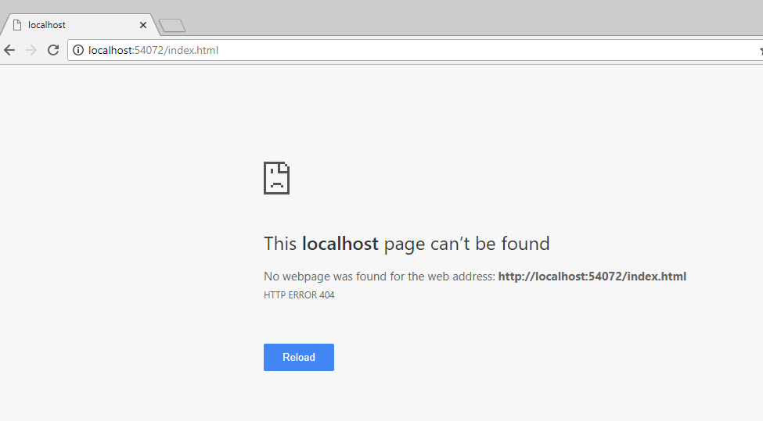
Ooops !!

Slide 38
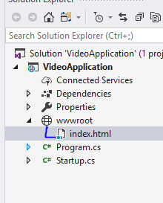
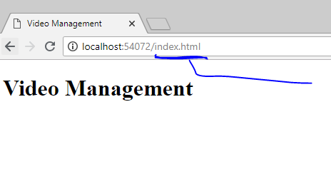
Move index file into wwwroot

Slide 39
All your JS, CSS, HTML and font files will
Always go inside wwwroot folder only

Slide 40
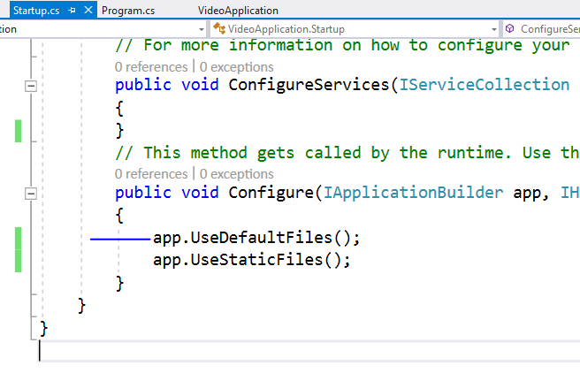
To serve html in this directory please add this
This order is important because
Middleware works based on that

Slide 41
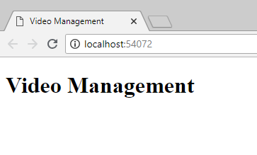
Now index page is visible on base URL

Slide 42
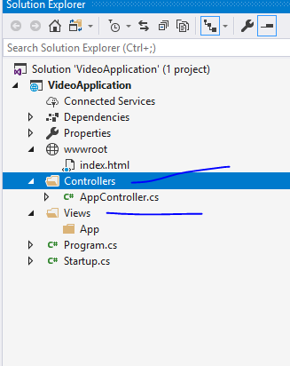
Add folders like this

Slide 43
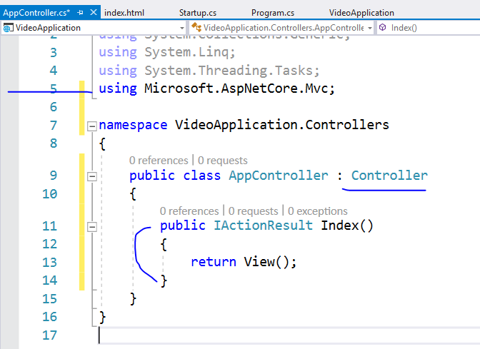
Add code
like this

Slide 44
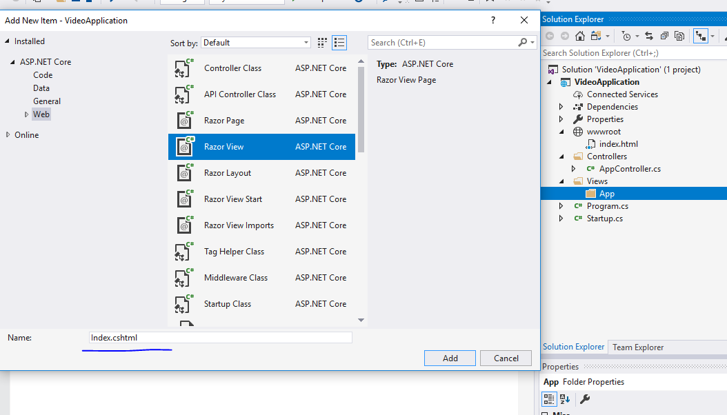

Slide 45
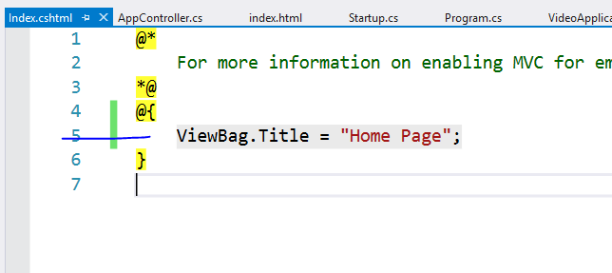

Slide 46
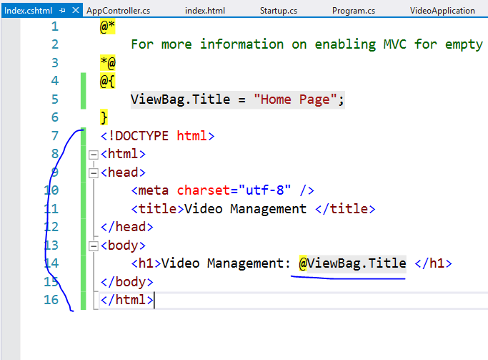

Slide 47
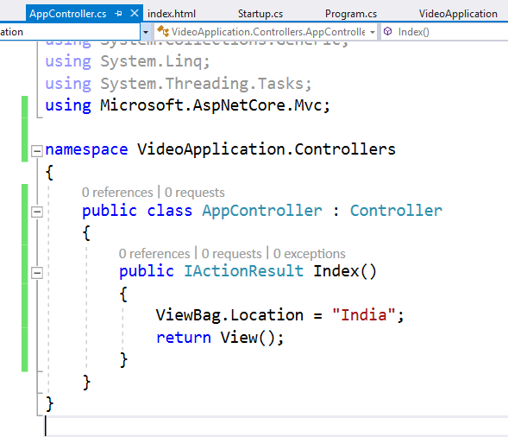

Slide 48
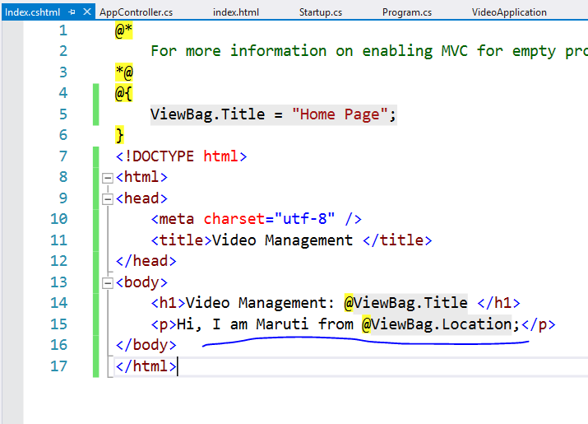

Slide 49
This will not run controller right now
Because we have not enabled MVC in this project
Let’s do it now

Slide 50
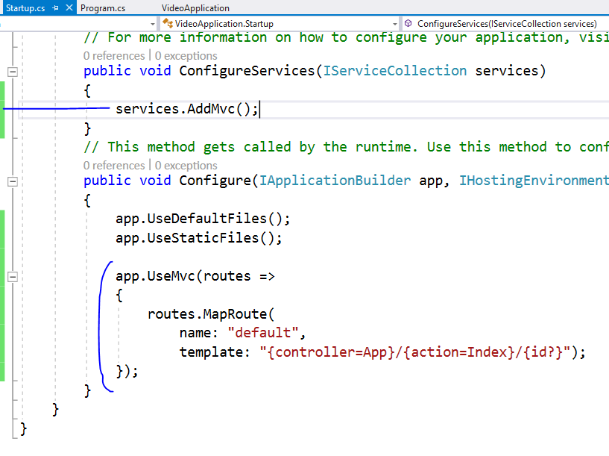

Slide 51
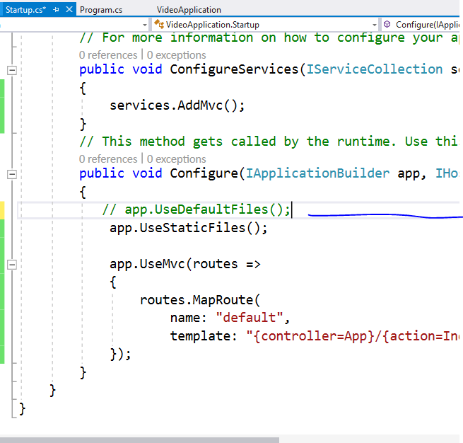
Comment this as
We don’t want to follow
File system path

Slide 52
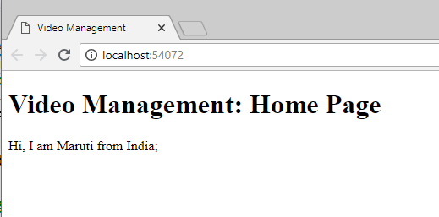

Slide 53
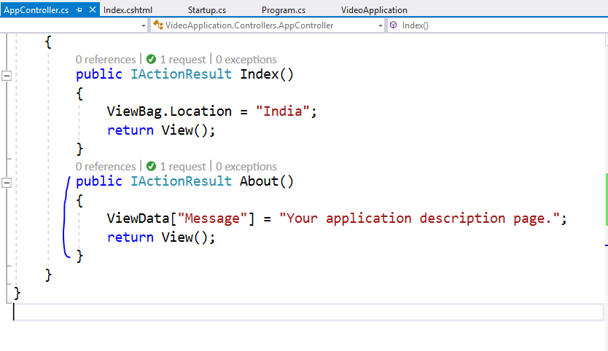

Slide 54
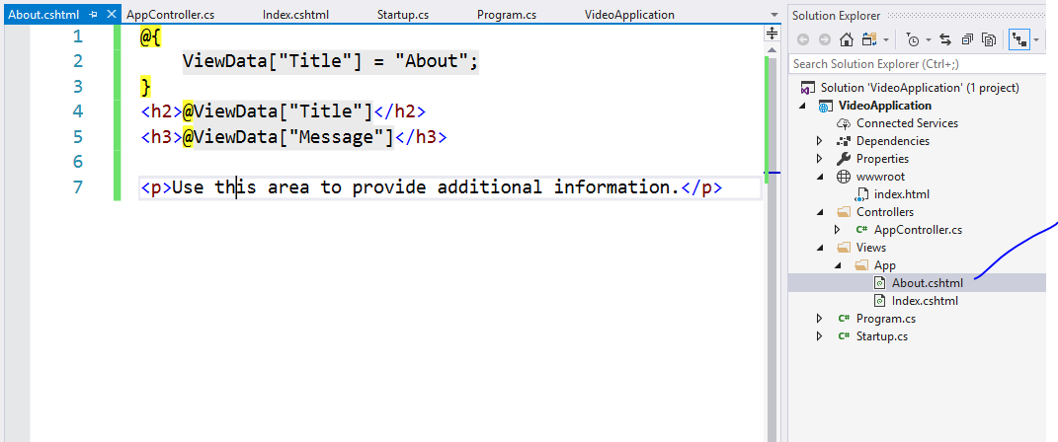

Slide 55
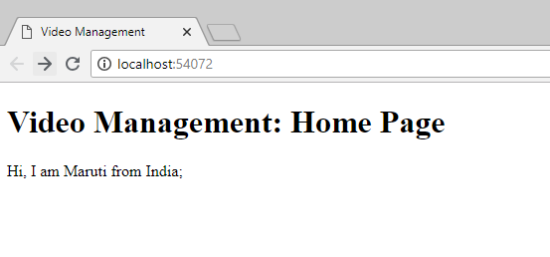
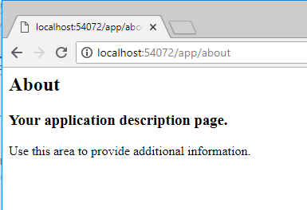
Type this url

